Slide 1


PAYROLL MANAGEMENT SYSTEM
PRESENTED BY
SANJAY. S [192211606]
ABISHEK. D [192211620]
GUIDED BY
S . JAYANTHI
INFORMATION SECURITY
Notes:
1

Slide 2

Introduction to Payroll Systems
1
Definition
2
Importance
A payroll management system is a software solution that automates the process of calculating, managing, and distributing employee wages and benefits. It handles tasks such as time tracking, tax calculations, deductions, and paychecks.
Effective payroll management is crucial for businesses of all sizes. It ensures accurate and timely payments to employees, maintains compliance with labor laws, and minimizes errors and disputes.
3
Key Features
4
Benefits
Payroll systems typically offer features such as time and attendance tracking, salary calculation, tax filing, direct deposit, reporting, and employee self-service portals.
The benefits of using a payroll management system include increased efficiency, reduced errors, improved compliance, enhanced employee satisfaction, and better financial management.
Notes:
2

Slide 3
Components of a Payroll Management System
Employee Data Management
Time and Attendance Tracking
Payroll Calculation Engine
The system stores and manages employee information such as names, addresses, tax IDs, pay rates, and benefits. This data is used to calculate wages and deductions accurately.
The system tracks employee work hours, overtime, sick leave, and vacation time. This information is used to calculate total hours worked for payroll purposes.
The system calculates gross pay, deductions, and net pay based on employee data, tax laws, and company policies. It generates pay slips and performs other related calculations.
Notes:
3

Slide 4
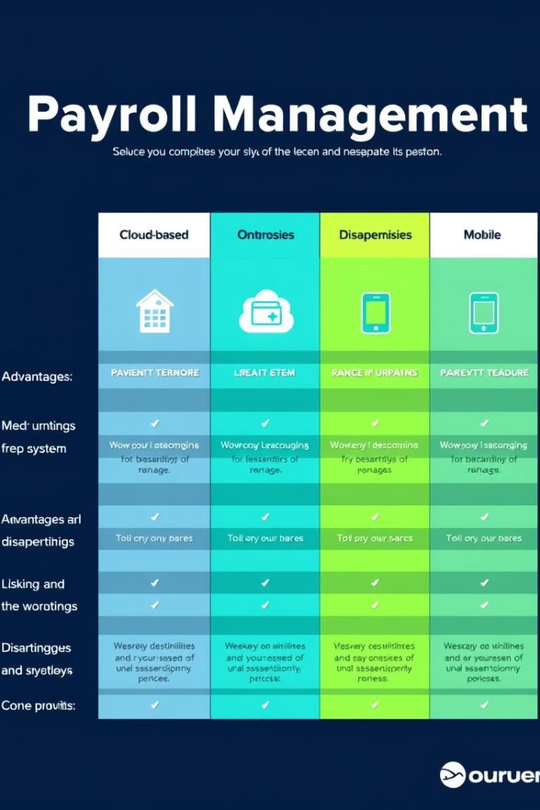
Types of Payroll Management Systems
Cloud-Based
Cloud-based systems are hosted on remote servers and accessed via the internet. They offer flexibility, scalability, and affordability but require a reliable internet connection.
On-Premise
On-premise systems are installed and maintained on a company's own servers. They offer greater control and security but require significant upfront investment and IT expertise.
Mobile
Mobile payroll systems are accessible through smartphones and tablets. They offer convenience and portability but may have limited features and security concerns.
Notes:
4

Slide 5
Benefits of Implementing a Payroll Management System
Increased Efficiency
1
Automating payroll tasks frees up time for HR professionals to focus on other strategic initiatives.
Reduced Errors
2
System-based calculations and data management minimize human errors, leading to more accurate payroll processing.
Improved Compliance
3
Payroll systems keep businesses compliant with changing labor laws and tax regulations, reducing the risk of penalties.
Enhanced Employee Satisfaction
4
Accurate and timely payments improve employee satisfaction and morale, contributing to a positive work environment.
Better Financial Management
5
Payroll systems provide real-time insights into payroll costs, enabling better financial planning and budgeting.
Notes:
5

Slide 6






Challenges in Implementing a Payroll Management System
Data Migration
System Integration
Training
Security
Transferring existing employee data to the new system accurately and securely is a critical initial step.
Integrating the payroll system with other HR systems, such as time and attendance, benefits, and HRIS, is crucial for seamless data flow.
Providing comprehensive training to employees and HR staff on the new system is essential for successful adoption and usage.
Ensuring the security of sensitive employee data is paramount, requiring robust security measures and compliance with relevant regulations.
Notes:
6

Slide 7

Choosing the Right Payroll Management System
Factor
Considerations
Business Size
Systems cater to different business sizes, with varying features and pricing.
Industry
Some systems are designed for specific industries, offering tailored features and compliance.
Budget
Consider the cost of the system, including licensing, implementation, and ongoing maintenance.
Features
Evaluate features such as time tracking, tax calculations, direct deposit, reporting, and employee self-service.
Integration
Ensure the system integrates seamlessly with existing HR and accounting systems.
Support
Evaluate the level of technical support provided by the vendor.
Notes:
7

Slide 8
Security and Compliance
Payroll systems handle sensitive employee data, making security paramount. Robust security measures are essential to protect against unauthorized access, data breaches, and cyberattacks.
Compliance with relevant laws and regulations is crucial. Payroll systems should comply with data privacy laws, such as GDPR and CCPA, as well as tax and labor laws.
Notes:
9

Slide 9




Implementation Process
System Selection and Customization
Data Migration and Integration
Training and User Adoption
Go-Live and Ongoing Support
The first step is to select the best system that meets the business's needs and budget. This includes customization to ensure compatibility with existing systems and data.
Transferring employee data and integrating the new system with existing HR and accounting systems ensures smooth transition and eliminates manual data entry.
Providing thorough training to employees and HR staff helps ensure they understand how to use the system and its features effectively.
The go-live phase marks the launch of the new payroll system, followed by ongoing support from the vendor for troubleshooting and system enhancements.
Notes:
11

Slide 10





Key Performance Indicators
Payroll Processing Time
Payroll Accuracy
Employee Satisfaction
Cost Savings
Track the number of payroll errors, such as incorrect deductions or payments, to ensure accuracy and minimize disputes.
Analyze payroll costs, including labor, software, and processing fees, to identify areas for improvement and cost optimization.
Measure the time it takes to process payroll from start to finish, including data collection, calculations, and disbursement.
Gather feedback from employees on the payroll process, including ease of access, timely payments, and communication.
Notes:
12

Slide 11
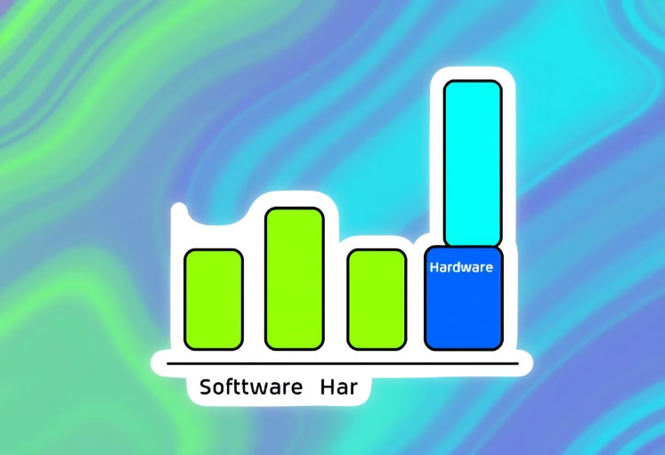
Payroll System Costs
Implementing a payroll system involves various costs. A budget should be allocated for software licenses, hardware, training, and ongoing support.
The cost of software licenses varies based on the number of employees, features, and vendor. Hardware costs include servers, computers, and peripherals.
Notes:
13

Slide 12


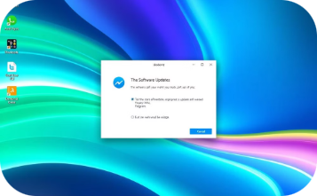

System Maintenance
Regular Checkups
Data Backup and Security
Software Updates
Monitoring and Troubleshooting
System maintenance ensures optimal performance and prevents costly downtime.
Regular updates patch vulnerabilities and ensure compatibility with current technology.
Backups safeguard against data loss and protect sensitive information from unauthorized access.
Proactive monitoring and prompt troubleshooting minimize downtime and ensure seamless operation.
Notes:
14

Slide 13
Pseudo Code
1.⁠ ⁠Class Definition: ⁠ Employee ⁠
- Attributes:
- ⁠ name ⁠: String to store employee's name
- ⁠ id ⁠: Integer to store employee's ID
- ⁠ salary ⁠: Double to store employee's salary
- Constructor:
- Takes ⁠ name ⁠, ⁠ id ⁠, and ⁠ salary ⁠ as parameters and initializes the attributes.
- Methods:
- ⁠ getName ⁠: Returns the employee's name.
- ⁠ getId ⁠: Returns the employee's ID.
- ⁠ getSalary ⁠: Returns the employee's salary.
- ⁠ setSalary ⁠: Sets the employee's salary.
2. Class Definition: ⁠ PayrollSystem ⁠
- Attributes:
- ⁠ employees ⁠: A list (vector) of ⁠ Employee ⁠ objects.
- Methods:
- ⁠ addEmployee ⁠: Takes an ⁠ Employee ⁠ object and adds it to the list.
- ⁠ removeEmployee ⁠: Takes an employee ID and removes the employee with the corresponding ID from the list.
- ⁠ calculatePayroll ⁠: Displays a payroll table for each employee:
- Loops through the ⁠ employees ⁠ list.
- Calculates the tax based on salary using ⁠ calculateTax ⁠.
- Calculates the net salary (salary - tax).
3.⁠ ⁠*Main Function:*
- Create a ⁠ PayrollSystem ⁠ object.
- Ask the user for the number of employees.
- For each employee:
- Take input for ⁠ name ⁠, ⁠ id ⁠, and ⁠ salary ⁠.
- Create an ⁠ Employee ⁠ object using the provided details.
- Add the ⁠ Employee ⁠ object to the payroll system.
- Call ⁠ calculatePayroll ⁠ to display the payroll details.
- ⁠ calculateTax ⁠: Calculates and returns the tax based on salary:
- If salary ≤ 5000: Tax is 10% of the salary.
- End program.
- Displays employee ID, name, salary, tax, and net salary in a formatted table.
Notes:
15

Slide 14
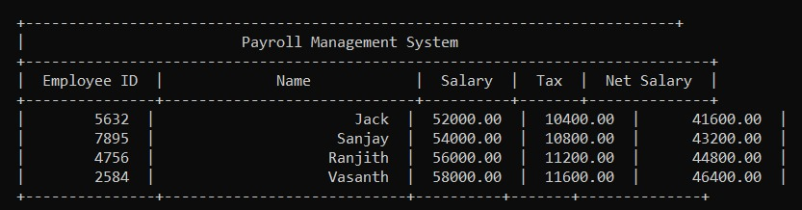
Output
Notes:
15

Slide 15

Conclusion
Implementing a payroll management system can significantly improve efficiency, accuracy, and compliance in payroll processing. By carefully considering the factors discussed, businesses can choose the right system to meet their specific needs and optimize their payroll operations.
Notes:
8

